Slide 1

User Engagement Analysis
PRIYA SINGH

Slide 2

Data Description
session_id → unique identification number for each session
customer_id → unique identification number for each customer
login_date → the date the user logged into Showwcase for that session
projects_added → boolean if at least one project was added
likes_given → boolean if at least one like was given
comment_given → boolean if at least one comment was given
inactive_status → boolean if the user was inactive or idle
bugs_occurerd → boolean if a user ran into at least one bug
session_projects_added → number of projects added
session_likes_given → number of likes given
session_comments_given → number of comments given
inactive_duration → number of seconds a user was inactive or idle
bugs_in_session → number of bugs a user ran into
session_duration → number of seconds a user was logged for that session
Dayofmonth -> created new variable from the login date

Slide 3

Research Questions:
How many of the users used all the features like project added, likes and comments? And sum of all the features wise?
Which day the site is mostly visited?
Which day is mostly visited for adding project?
Which day is mostly visited for giving comments?
Which day is mostly visited for liking?
Which day bugs are most reported?
How is session duration dependent on features?

Slide 4
How many of the users used all the features like project added, likes and comments? And counts of each of the user for all the features?
There were 33 users out of 48 who used all the features like adding projects, likes and comments
Project_Added = 227
Comments_given = 225
Likes_given = 213

Slide 5
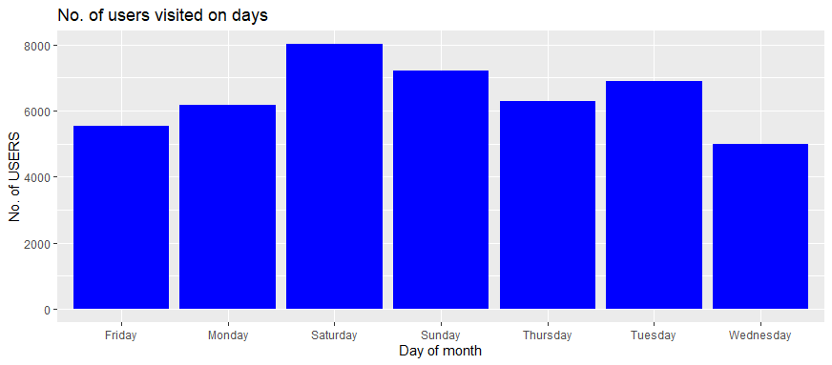
Which day the site is mostly visited? Saturday is mostly visited by users

Slide 6
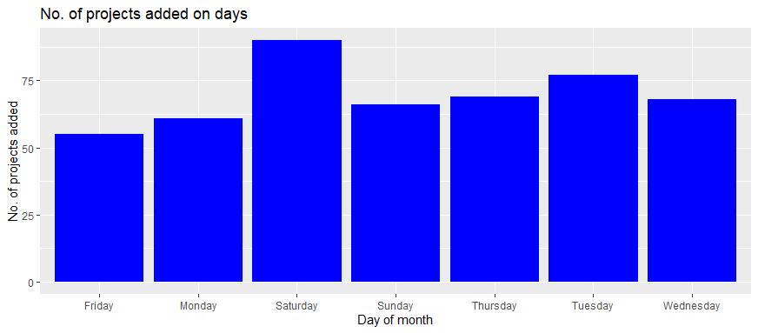
Which day is mostly visited for adding project?

Slide 7
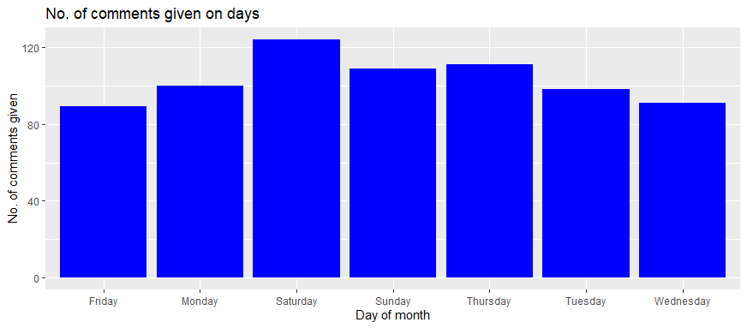
Which day is mostly visited for giving comments?

Slide 8
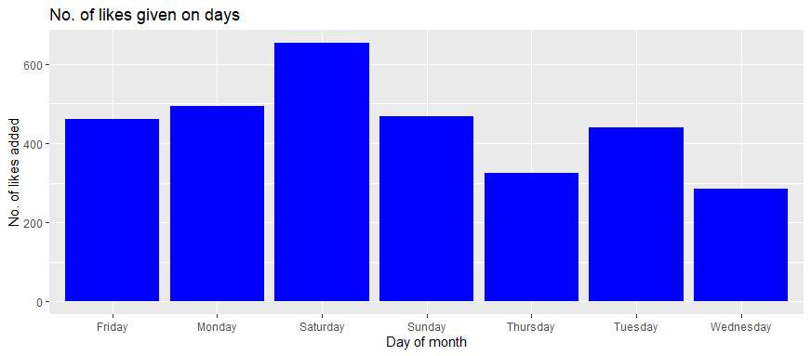
Which day is mostly visited for liking?

Slide 9
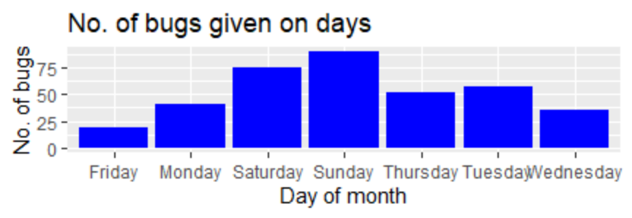
Which day bugs are most reported?

Slide 10
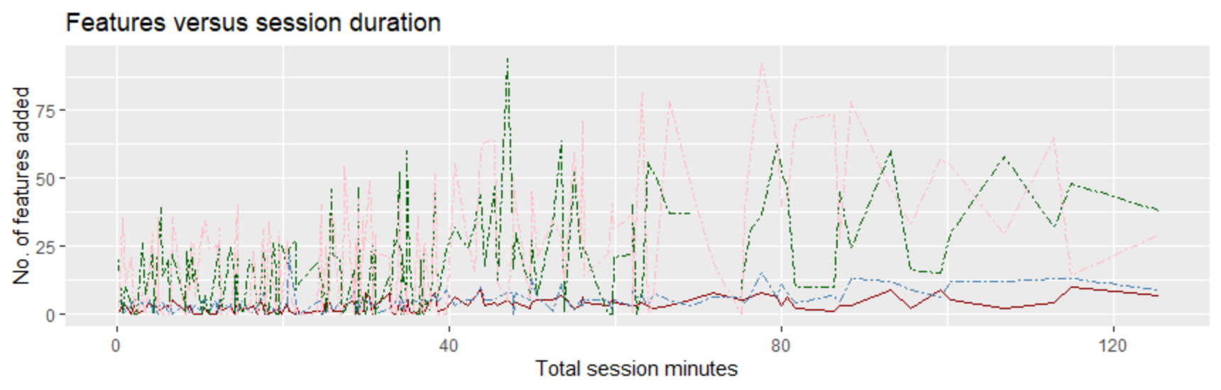
How is session duration dependent on features?
Likes
Project
Comments

Slide 11
Results
The site is mostly visited on Saturday
Features like projects, likes and comments are mostly done on Saturday.
Most of the users are repeatedly using the platform for various features
Most of the bugs are reported on Sunday which might be the reason that users visit mostly on Saturday.
There are a greater number of likes given than projects added, and comments given.
The projects added is in low numbers than likes and comments

Slide 12
Conclusion
For applying machine learning model or correlation, the dataset seems to be small to achieve accurate results.
Future related work can be focused on demographics of the user like age, location, device used etc.

